Slide 1

https://spark.apache.org/
Notes:
https://spark.apache.org/

Slide 2
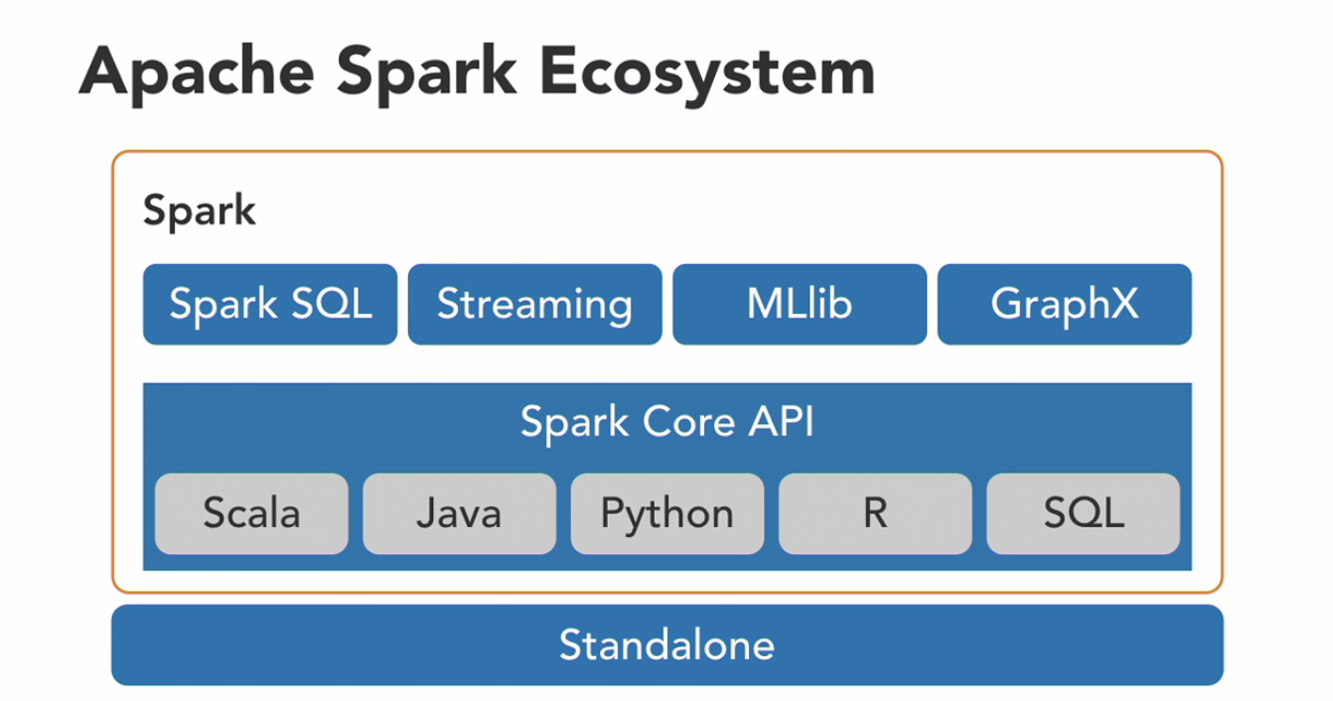

Slide 3
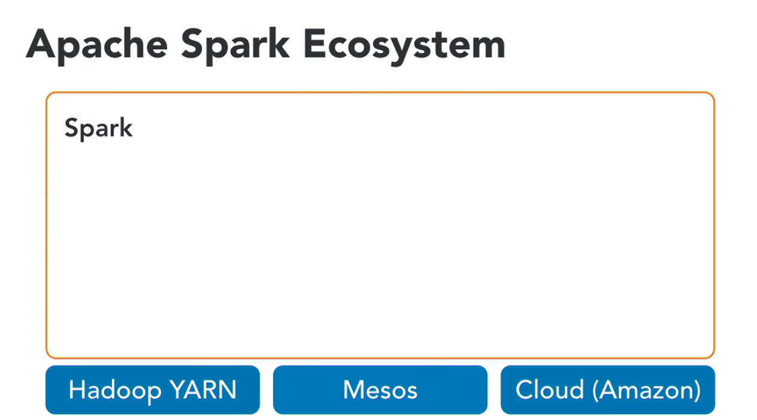

Slide 4
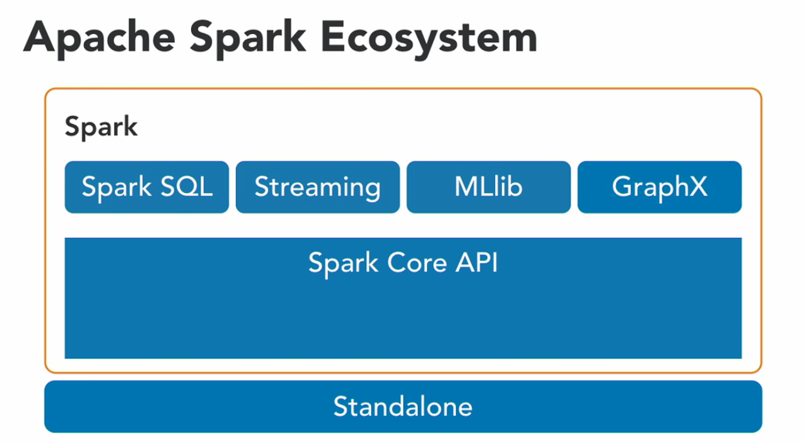

Slide 5
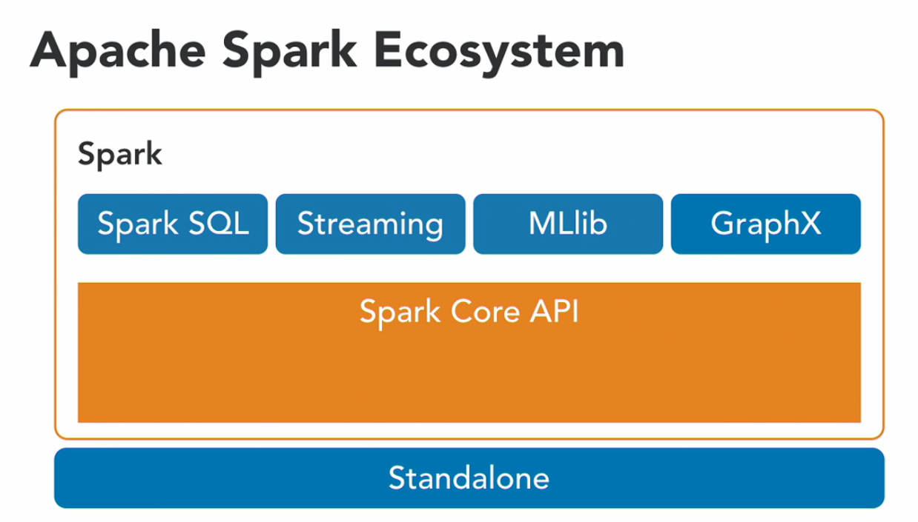

Slide 6
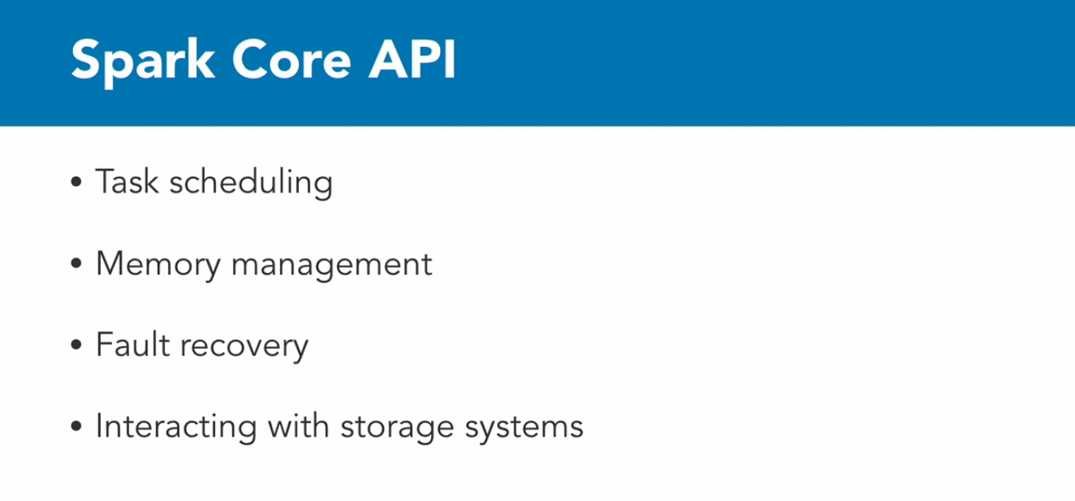

Slide 7
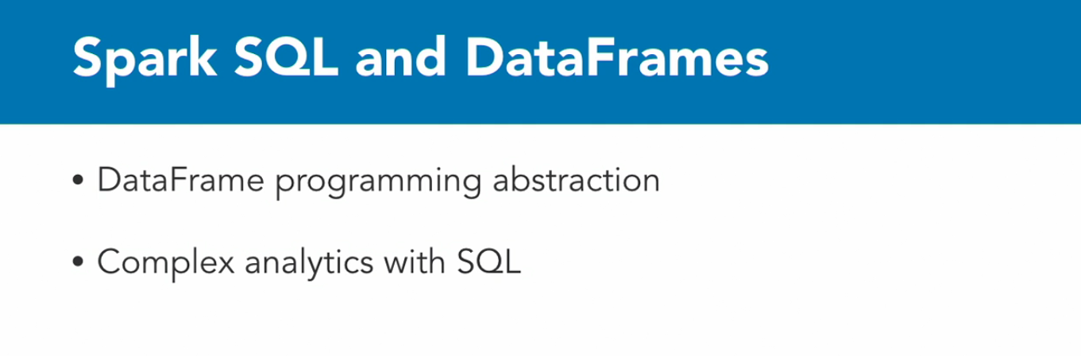

Slide 8
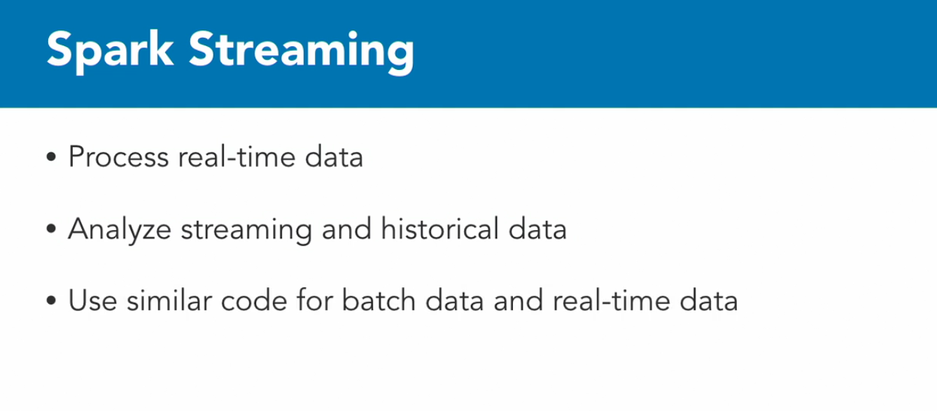

Slide 9
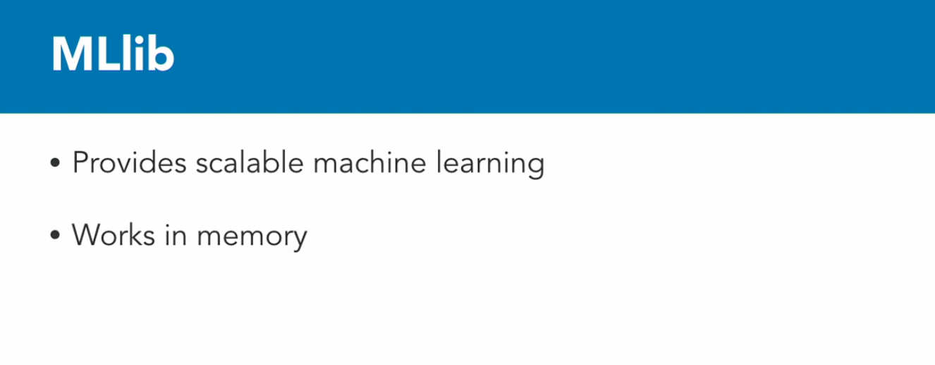

Slide 10
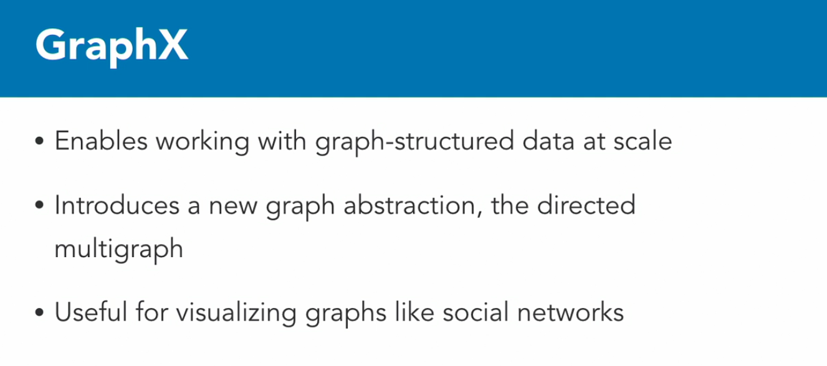

Slide 11
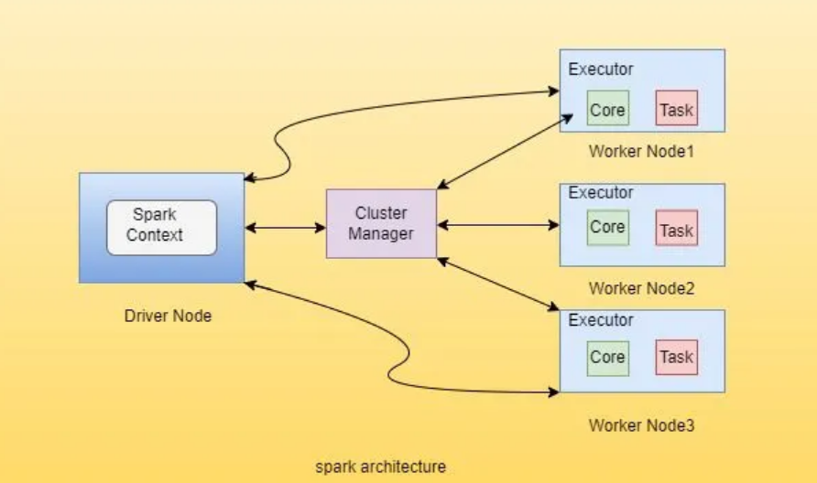
Notes:
https://sparkbyexamples.com/spark/what-is-apache-spark-driver/

Slide 12
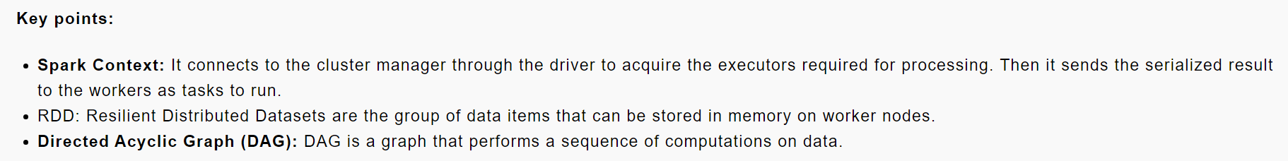
https://sparkbyexamples.com/spark/what-is-apache-spark-driver/
Notes:
https://sparkbyexamples.com/spark/what-is-apache-spark-driver/

